Slide 1

Physicochemical & Pharmacokinetic Dataset Mining and Insights
Taylor Townes
14JUN24

Slide 2
Brief Data Set Descriptions -
Three related data sets that include physicochemical, pharmacokinetic, gene, and target assay fields:
Compound_Off_Target_Activity
This dataset provides a detailed view of the off-target activities of various compounds, helping in the assessment of compound specificity and potency.
It can be used to identify potential off-target effects.
Gene_Drug_Adverse_Event_Relationships
The dataset provides a comprehensive view of the complex interactions between genes, drugs, and adverse events.
It can be used to understand which genes are associated with certain adverse events when specific drugs are administered, helping in the assessment of drug safety and the identification of potential side effects based on genetic information.
Project_Level_Data
This dataset holds the compounds' properties & activities in relation to the primary target.
It helps to understand the compounds' physicochemical, bioactive, and pharmacokinetic properties.

Slide 3
Data Preprocessing

Slide 4
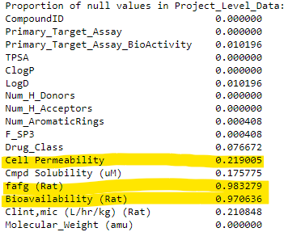

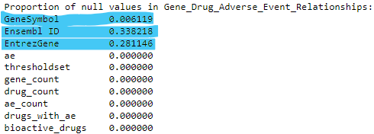



Data Preprocessing -
Combined columns with same values - MW & Molecular_Weight.
Checked the proportion of null values for each field in each dataset.
Mapped Gene-Ensembl ID-Entrez Gene ID relationships to fill missing data & pulled further missing data from web sources.
Removed duplicate rows from each dataset.

Slide 5
Physicochemical Properties & Bioavailability Relationship Exploration

Slide 6
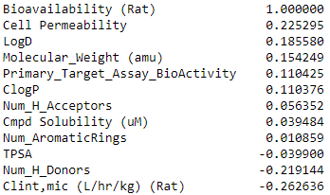
Physicochemical Properties & Bioavailability Relationship -
Expected:
Positive Correlations:
Cell Permeability & Compound Solubility
Negative Correlations:
TPSA, Number of H Donors, Number of H Acceptors, Molecular Weight, CLint
Observed:

Slide 7
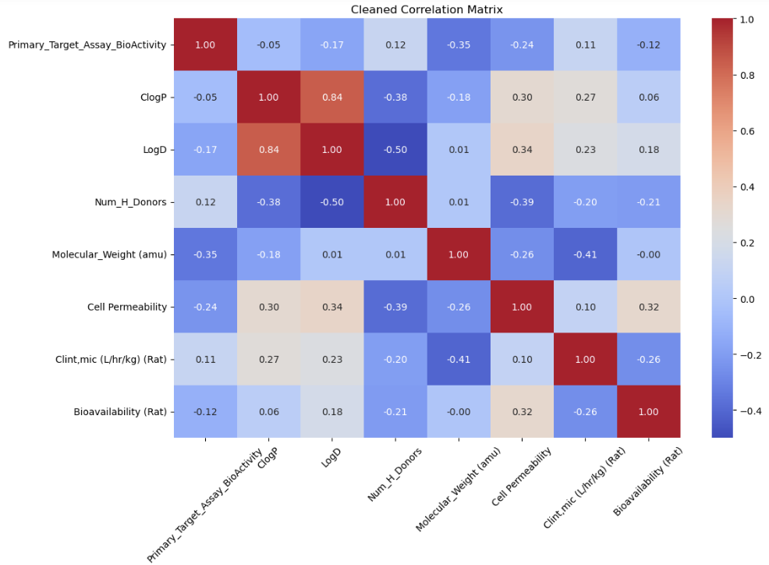
Physicochemical & Bioavailability Correlation Matrix

Slide 8
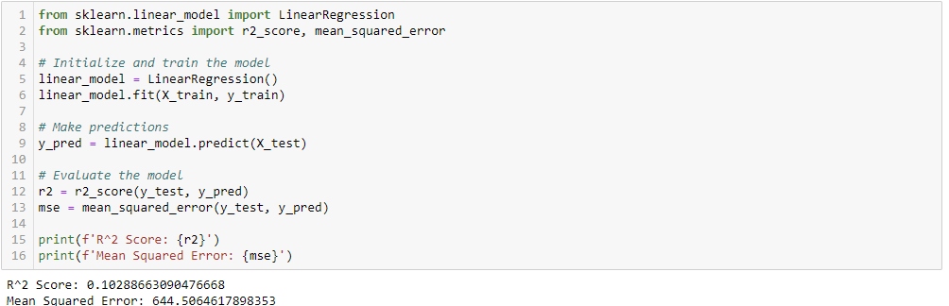
Predicting Bioavailability Using Highest Correlated Features -
Used Linear Regression Model to Predict Bioavailability based on features.
The R² value, 0.1029, shows a weak ability to accurately predict bioavailability based on these features.

Slide 9
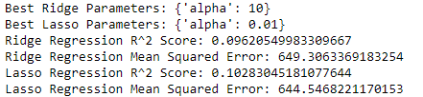
Predicting Bioavailability Using Highest Correlated Features -
Used Gradient Boosting, Lasso & Ridge Regression, & Hyperparameter Tuning to achieve a more accurate prediction model.
The R² values did not improve from the original linear regression.
This indicates that there is not a strong linear relationship between the bioavailability of the drugs and the features chosen, and this limited bioavailability data cannot easily be used to predict other compounds’ bioavailability based on the presented physicochemical properties.

Slide 10
Predicting Bioavailability Insight Summary -
The data set contains very little data for Bioavailability (~3% of compounds)
Bioavailability does show weak to moderate correlations to a few physicochemical features.
The relationship between the physicochemical features and bioavailability is not strong enough in this data set to use in predictive models to fill in missing bioavailability data or predict future compounds’ bioavailability. More data is needed.

Slide 11
Primary Potency and Selectivity
(Off-Target Bioactivity)

Slide 12
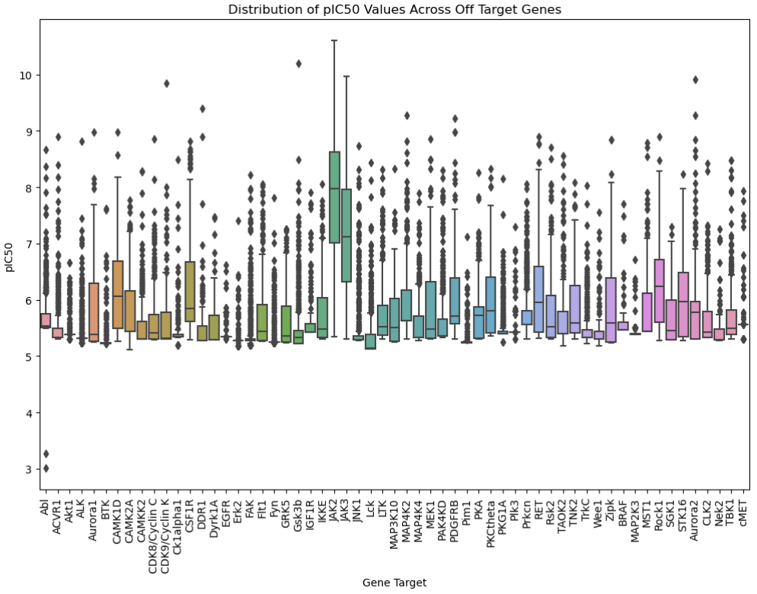
Primary Potency and Selectivity (Off-Target Bioactivity) -
This box plot provides a visual summary of the distribution of pIC50 values across various gene targets, highlighting differences in potency and variability.
The high means and generally wide IQRs and frequency of outliers suggests that these compounds may have lower selectivity and variable potency.

Slide 13
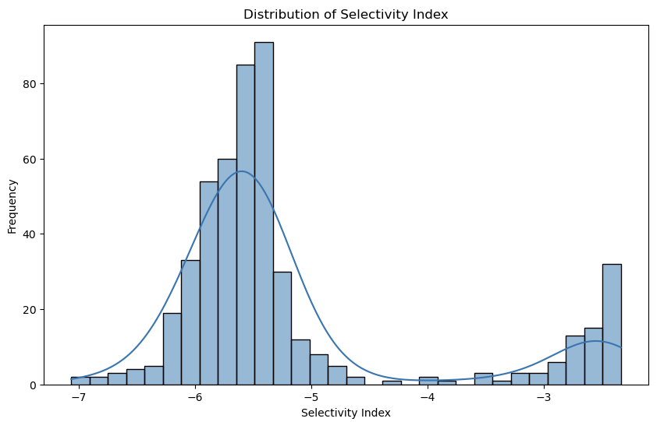
Primary Potency and Selectivity (Off-Target Bioactivity) -
By linking off-target activities to adverse events associated with specific genes, we can explore how selectivity (or lack thereof) contributes to adverse events.
The negative skew of the Selectivity Index indicates that many compounds in the dataset have lower selectivity.
These compounds may be less potent against their primary target compared to their average potency against off-targets.
This lower selectivity could lead to more adverse reactions in off-target genes.
Notes:
The histogram suggests a need for optimization to improve selectivity. Compounds with a more positive Selectivity Index would be more desirable as they are more likely to be potent against their intended target while minimizing off-target interactions.

Slide 14
In Vitro to In Vivo Properties

Slide 15
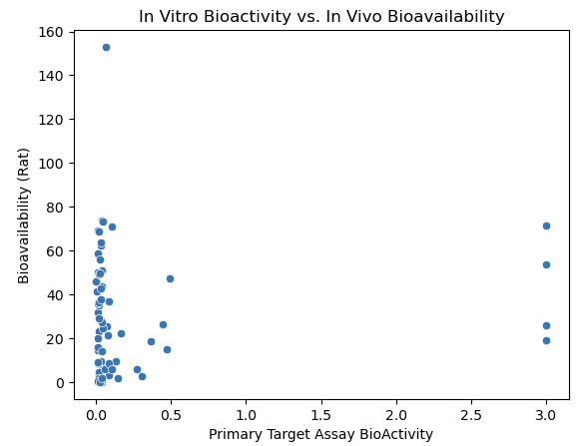
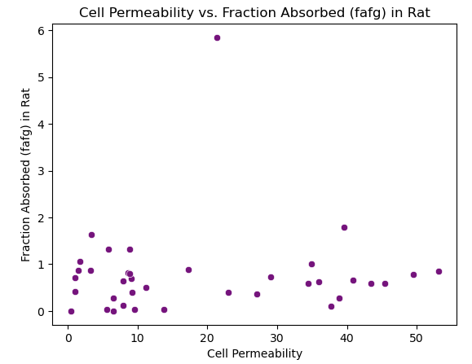
In Vitro to In Vivo Properties -
We can compare in vitro properties like assay bioactivity, cell permeability, and solubility with in vivo properties such as bioavailability and F_{a}F_{g} (fraction absorbed).
The high clustering near low bioactivity suggests that many compounds are potent in vitro but show a wide range of bioavailability in vivo.
Both plots indicate a lack of strong correlation between the in vitro and in vivo properties analyzed. This suggests that factors other than those plotted might be influencing the in vivo outcomes.
The presence of outliers in both plots warrants further investigation to understand the unique properties of these compounds that lead to their unusual bioavailability or absorption.

Slide 16
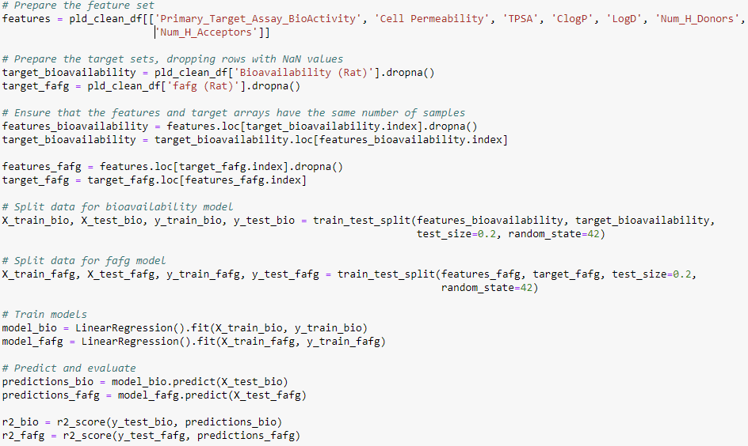
In Vitro to In Vivo Properties -
To gain deeper insights, we perform a multivariate regression analysis to see how multiple in vitro properties jointly predict in vivo outcomes:
R² score for bioavailability was -0.54 & the R² score for F_{a}F_{g} was -5.4.
This indicates that the models do not fit the data well & that the selected features do not explain the variation in bioavailability or F_{a}F_{g} .

Slide 17
In Vitro to In Vivo Properties Next Steps -
Exploring additional features or different sets of features that might have a more direct impact on bioavailability and absorption.
Consider using more complex models like decision trees, random forests, or neural networks that can capture non-linear relationships.
Incorporate domain knowledge to select more relevant features. For example, considering metabolic stability, specific enzyme interactions, or other pharmacokinetic properties that could influence bioavailability and absorption.

Slide 18
Next Steps

Slide 19
Data Exploration Next Steps -
Create a column with a binary key for neutral/ionizable in relation to the LogD & CLogP values.
Use external or other larger domain set that has more bioavailability, absorption, & clearance data to train an ML model to more accurately predict for this dataset.
Examine relationship between adverse events, selectivity, & potency of compounds.

Slide 20
Q&A

Slide 21
Appendix -
See GitHub for full code: https://github.com/tktownes/AbbVie-Interview-Presentation

